Slide 1
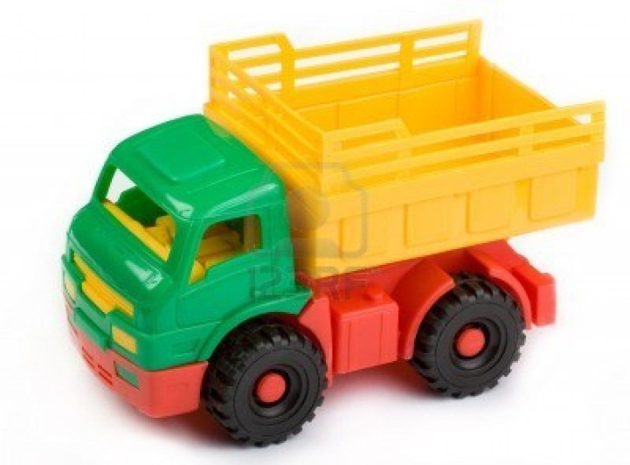
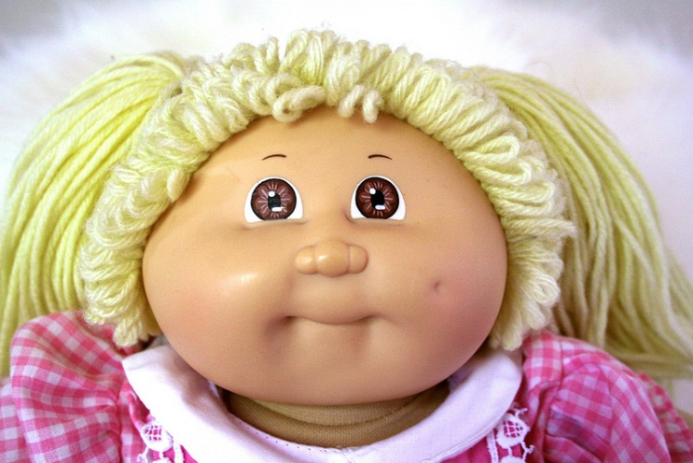
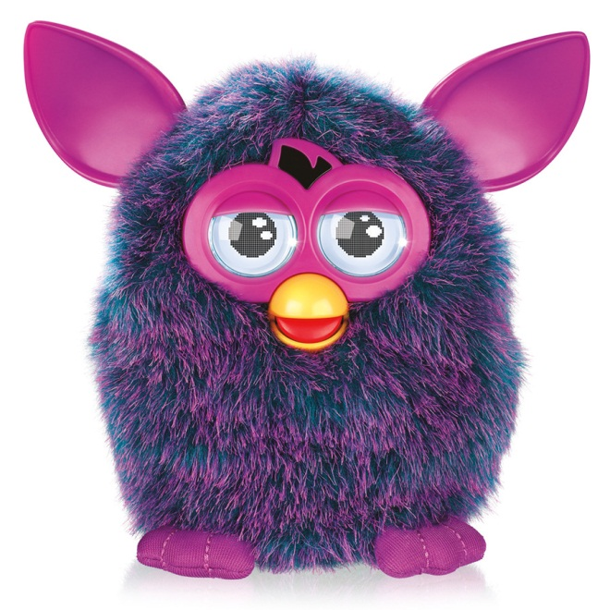

Slide 2
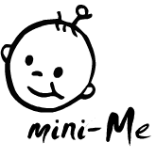
- mini-ME is a company that sells customized dolls. These dolls are created with your features by technologies such as facial recognition and the input of our patented “personality chips”.
Akeem Allen
Magdelin Rodriguez
Kenzel Roberts
Anteja Owens

Slide 3
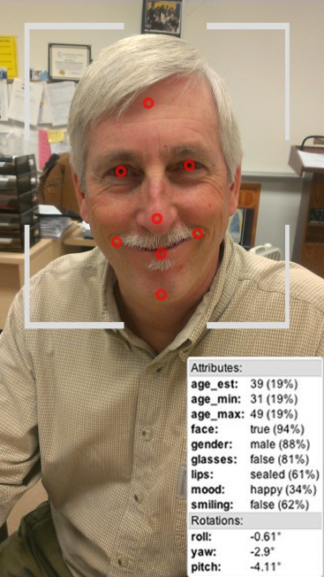
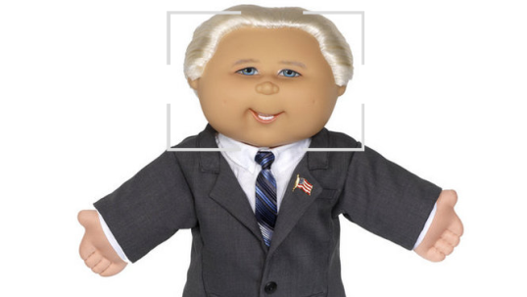
Mission
Mini-Me, Inc. will provide its customers with customized dolls that are designed and created with the consumer’s needs and use of the product held at the highest priority.

Slide 4
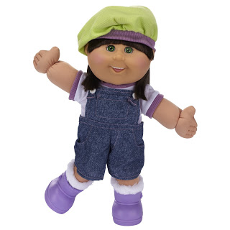
Opportunity
Changes in an existing product
Buyer has a opportunity to individualize doll’s:
Face(with your face)
Hair to match your hair
Personality of your choice (implant technology that allows it to have a personality/emotions)☺☹
Clothing of your choice

Slide 5
Competitive Advantage
Cabbage Patch Kids
Do not offer customization and personality technology that we do
American Girl
We use facial recognition customization; not template customization
$220
$50
$70

Slide 6
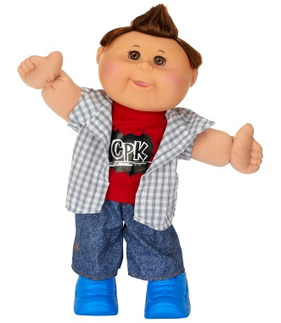
Who is your product targeted to?
The target market of our company is young people ages 3 through 12 whose parents have a disposable income to spend on toys, and live in suburban areas. Our company is marketing specifically to only children who do not have siblings, and are in want of a companion of their own.

Slide 7
How to promote mini-ME
Attracting the interest of toy store businesses
Send emails, video clips, phone calls to have them sponsor us.
Television Commercials
30 seconds; have a few people take a picture and have it shaped into them fast pace. Nickelodeon, Cartoon Network, PBS, Sprout, Hub, Discovery Kids.
Flyers
Pass them out in toy stores
Booths
Place computers with facial recognition program and take pictures of them and give them a sketch of how it would look.
Build a website
Intro on who we are and what’s the purpose of the doll.

Slide 8
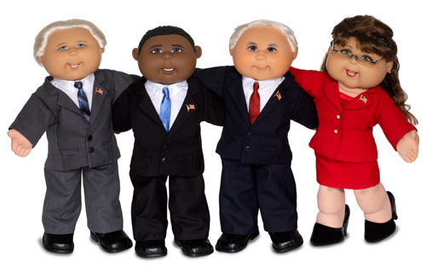
Here’s an example: A few teachers in
The building ordered some and once
They shipped in, you could tell who are
who.
Mr. Griffin 2. Mr. Champlain 3. Mr. DP
And last but not least 4. Ms. Dougherty!

