Slide 1
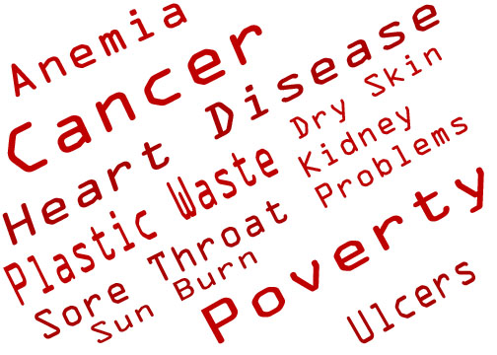
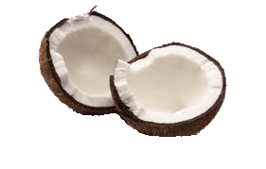
Notes:
We’ve all been hurt in one way or another by cancer, pollution, or heart disease. What hits closest to home for me, and I mean this literally, is poverty. Every time I return to the Philippines where I was born, I see poverty that just breaks my heart. I see a proud people who don’t have the opportunity to lift themselves out of this mire. I see a land full of untapped, renewable resources. In a nutshell, I see an opportunity

Slide 2
“Business Venture for Social Change”
Nathan Hart
18 Years Old
12th Grade
Notes:
Hello, My name is Nathan Hart, and I am Hart for the Poor

Slide 3
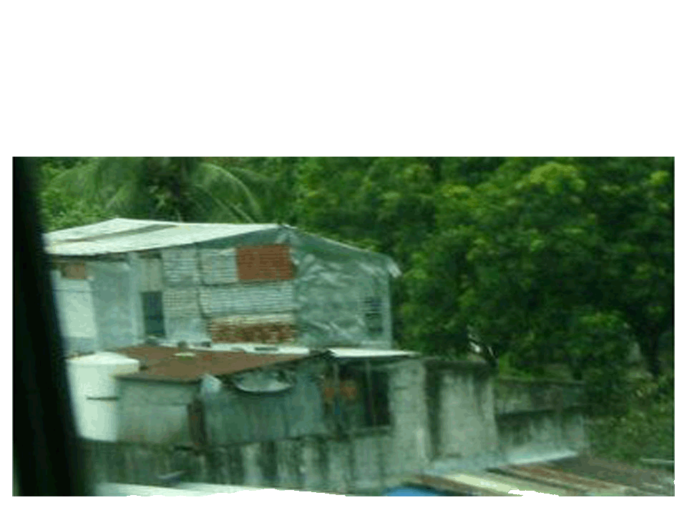
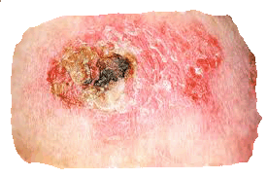
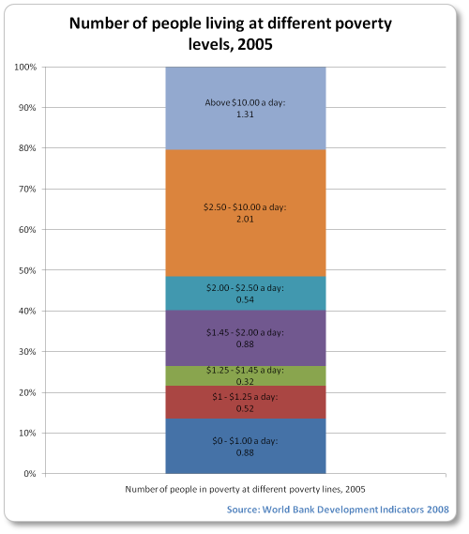
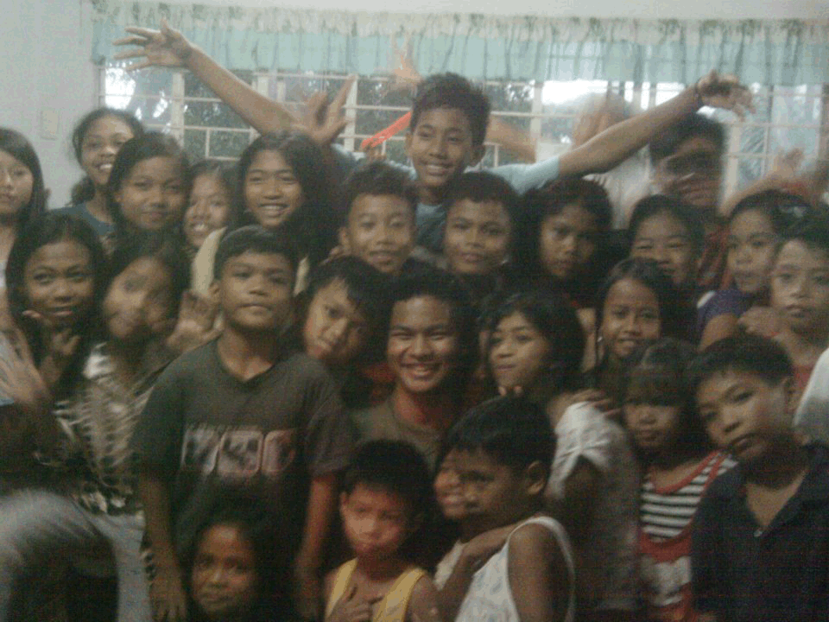
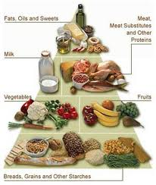
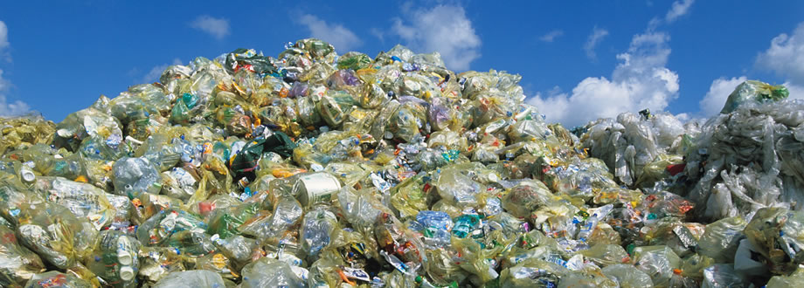
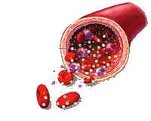
Opportunity
Pollution
Health Food
Disease
Poverty
Notes:
Opportunities for my product include the rise of pollution from plastic waste. In 2010, the United States produced 31 million tons of plastic waste. Health foods are also becoming more popular. This will be elaborated in the market analysis section.
NVSS reports that diseases of the heart, and malignant neoplasms, (tumors) are the two leading causes of death in America. But of all these, Poverty is what I see as the greatest opportunity. 80 percent of the world lives at less than $10 a day. 1/6 of humanity lives in slums. In the Philippines alone, that’s 20 million people living in slums. Of that, 13 million children in the Philippines live on less than $2 a day because their parents can’t support them. As a result of that, 22,000 children die worldwide each day because of poverty. That’s one child dying every 3.5 seconds

Slide 4
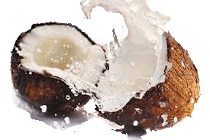
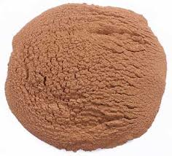
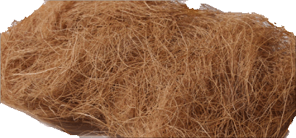
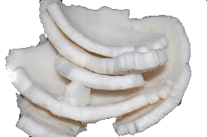
Solution
Coconut Shell Powder
Biodegradable plastic
Coconut Fiber
Textiles, Erosion Control
Coconut milk, Coconut meat, Coconut oil, Coconut Water
Dietary Restrictions
Nutrients
Heart Disease
Weight Control
Arthritic Pain
Cancer
Poverty
Notes:
The shell, ground into a powder, can be used in making biodegradable plastics. The fiber can be used in non-woven textiles, erosion control, rope manufacture, and as a substitute for sphagnum moss in horticulture. The coconut meat, oil, and water are halal, kosher, and can be consumed by those who are lactose intolerant. Nutrients in coconuts have been shown in research by the American Society of Nutrition, Visayas State University, and many other independent researchers to cut down heart disease, promote weight control, soothe arthritic pain and even inhibit cancer cells.
What my company focuses most on is poverty. Hart for the Poor plants factories in tropical countries, and pays fair trade wages for its workers.

Slide 5
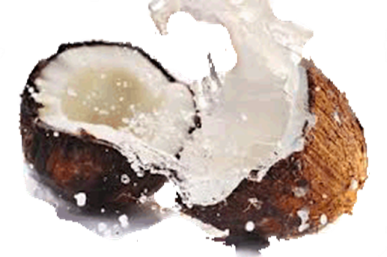
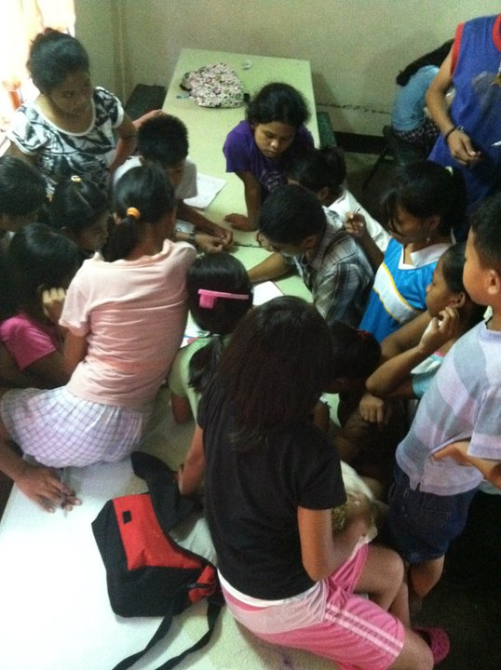
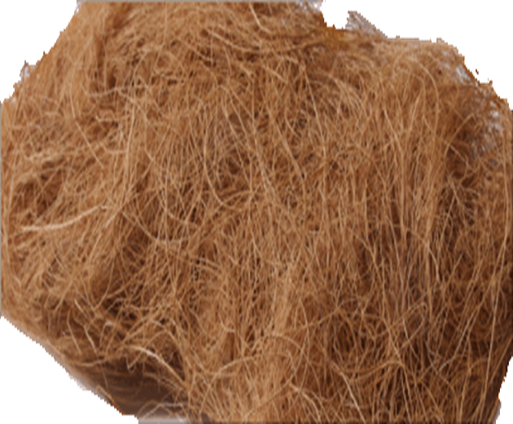
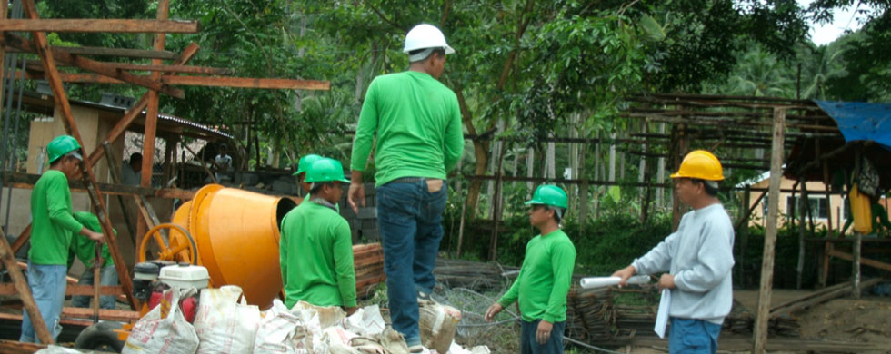
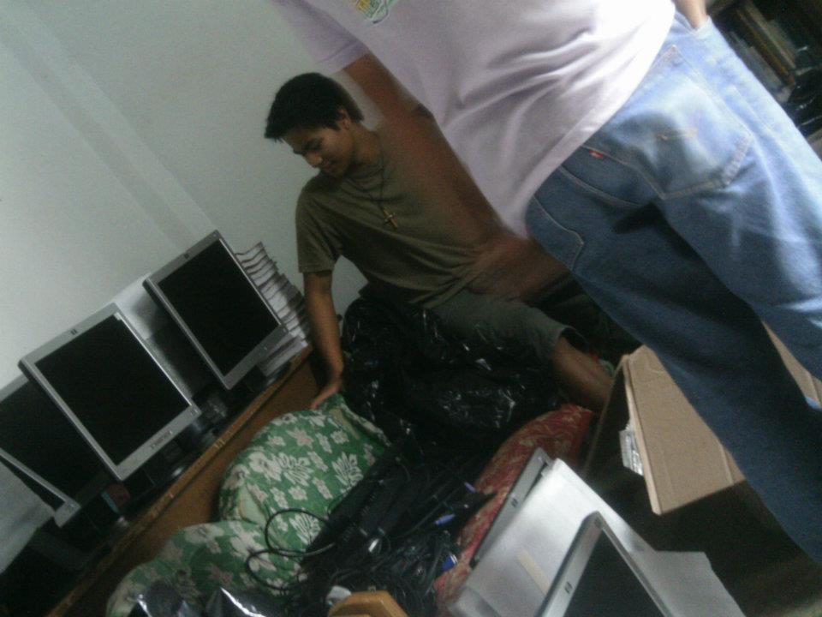
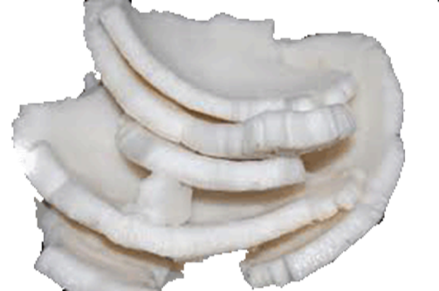
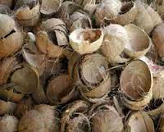
Description of Product
Community Transformation
Zero Waste
Fertilizer
Distilled Water
Education
Mathematics
Agriculture
Economics
Entrepreneurship
Local Farmers
Notes:
Hart for the Poor promotes the transformation of communities by building community transformation plants. These community transformation plants are factories that process raw coconut materials. They promote the general economic growth of the area by connecting poverty-stricken areas directly to the global economy. In the U.S. Hart For the Poor will run a wholesale business, selling to stores and factories.
Currently, mills are designed to maximize the production solely of coconut oil. They discard the water, milk, husks, and shells as waste. With Hart for the Poor, 100% of the coconut is used: from the husk to the shell to meat and water. Nothing is wasted. Apart from previously mentioned exports, Hart for the Poor will also sell within the Philippines fertilizer made of flecks from the husk produced by the stripping process, as well as distilled water which is a by-product of other processes in the Community Transformation Plant.
To feed these Community Transformation Plants, it will be necessary to promote an educated workforce, so along with these plants, Hart for the Poor will also set up schooling for local students, educating them in mathematics and agriculture, as well as economics, and entrepreneurship. In addition to this, Hart for the Poor will educate farmers in the use of modern agricultural techniques such as using modern processing equipment that can triple the efficiency and cleanliness of the products.

Slide 6
Definition of One Unit
1 day’s production
Economics of One Unit
Selling Price |  | $8,700
Cost of materials | $850
Cost of labor | $1,600
Other variable costs | $1,605
Total COGS/ COSS |  | $4,055
Contribution Margin |  | $4,645
Monthly Break Even Units
$125,000 | = | 26.910 | ≈ | 27
$4,645
Notes:
1 day’s production, Hart For The Poor will process over 16,000 coconuts a day from surrounding farming areas.
Total cost of goods sold will be 4,055, meaning the complete processing of an entire coconut will come out to 23 cents a coconut.
With a contribution margin of 4,645, My monthly break even units will be approximately 28.

Slide 7
[Market Analysis]
Market Statistics
Industry Name: | Organic Food Plastic Manufacture Textile Manufacture | Annual Industry Sales: | $42 Billion
Description of Target Consumer
Demographics | Geographics
Chain Stores Smaller Grocery Stores Textile Manufacturers Plastic Manufacturers Car manufacturers | New England
Psychographics | Buying Patterns
Philanthropists Environmentally Friendly | Whole Foods Trader Joe’s Geissler’s Big Y Farmers Markets
Target Market Size
Textile, Plastic, Car manufacturers World Wide
600,000
Textile, Plastic, Car Manufacturers, U.S.A
1,000
Market size
(based on
survey)
25
Notes:
Hart for the Poor is both Manufacturer and Wholesaler. As mentioned before, Hart For the Poor in the Philippines will process raw coconut materials. In the U.S. our company will be wholesalers, selling to stores and factories.
From 2005 to 2009, the market for “natural” and “organic” foods grew 85% in spite of the economic recession. As we as a nation recover from the effects of the recession, consumers will start to acquire more disposable income, and in turn spend more. By 2014, organic food sales are predicted by the Western Washington University to reach 42 billion dollars. I will be selling to stores such as wholefoods and to Farmers Markets.
Hart For The Poor will target those interested in promoting the well-being of humanity in poorer countries, as well as those involved in promotion of “green” products.
In regards to plastic and textile, I will be selling Coconut Powder for plastic fill and Coconut Fiber for non-woven Textile to environmentally friendly companies such as Green Textile Associates, Inc. Ningbo Green Textile Co. and NEW Plastics, as well as Car manufacturers such as Ford and Chevrolet.
There are over 600,000 textile, plastic, and car manufacturing plants world-wide, and over 1,000 in the U.S.A. Based on the amount that I can process in a single factory, as well as the contacts that I have already made in the industry, I will begin by supplying goods to around 25 factories.

Slide 8
Promotion and Sales
Use of Connections
Advertisements through GCM Network
Emphasis on Social Entrepreneurship, and “Green” Manufacture
Cutting out the “Middle Man”
Notes:
In regards to Promotions, I will use the connections that I have established through my time with Dignity and GCM, which will be elaborated in my qualifications. I will also promote my product through GCM’s network of various sponsors in the U.S.A, many of whom are high ranked members in companies such as AT&T, Wal-Mart, and the like, and authorities in the Philippines.
I will be focusing on the social entrepreneurship aspect of my company, particularly the fact my company will be educating, providing jobs, and connecting local workers to the global economy, as well as providing jobs here in the U.S. Coconut powder and Coconut shell fiber will be used in Green Manufacture of Plastics and Textiles, which will be advertised on the products made.
Most products are manufactured, then sold to a wholesaler, who then sells to a retailer. Hart for the Poor, being both manufacturer and wholesaler, cuts out the middle man, keeping prices low and funneling the savings not only to the buyer, but also the workers in the factories.

Slide 9
Competition
Direct Competition
Dignity Coco LLC.
Nutiva
Celebes Coconut Corporation
Indirect Competition
Earth’s Best
Organic Valley
Organic Farmers
Notes:
My Direct Competition includes companies such as Dignity Coco, Nutiva, and Celebes Coconut Corporation
Dignity will be a sister business, as I have drawn inspiration from their endeavors. However, I am hoping to delve even deeper in the planting of educational systems, whereas Dignity uses already existing institutions.
Nutiva Celebes are already established as big names in the coconut industry, but don’t focus on the welfare of the people. To make profit they take advantage of local workers. My company will offer more desirable working conditions, which appeals to the sympathetic, and to local workers, who will be drawn away from other plants.
Indirect competition includes organic food companies such as Earth’s Best, Organic Valley, and Local Farmer’s Markets.
Earth’s Best and Organic Valley are also well known and established. They have a reputation of high quality within health circles, but again fall short in the philanthropy aspect.
Organic Farmers, while popular locally, are limited in their products. They are very expensive. My products are more exotic, which draw those looking for unique remedies, and the price is kept low by cutting out the middle man.

Slide 10
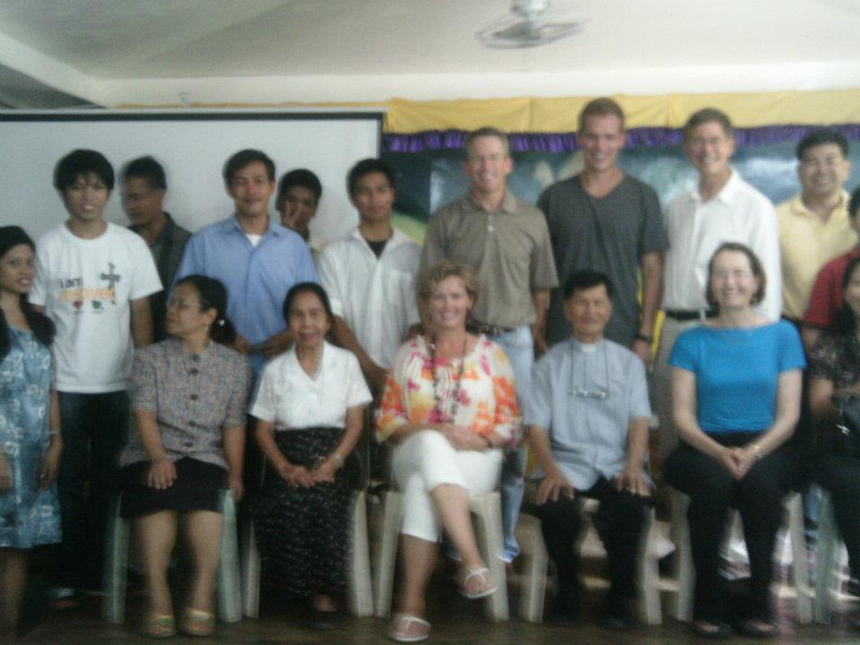
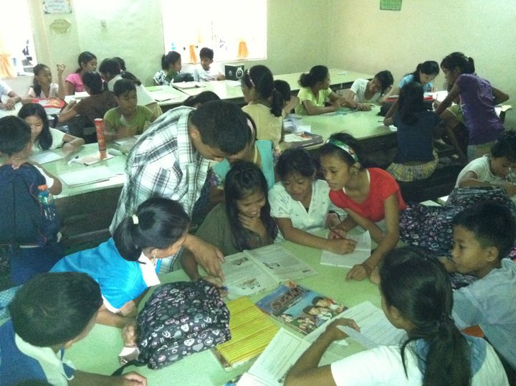
Qualifications
Longtime Involvement with Dignity Coco, LLC.
Don Byker, Chairman
Stephen Freed, CEO
Shawn McKenzie, Vice Chairman
Darrel Campbell, Buyer for Ford
Longtime Involvement Grace Christian Mission
Cultural Knowledge
Notes:
I have been involved with Dignity Coco, LLC since its inception. Two summers ago, my father and I traveled to the Philippines at the request of Don Byker, chairman of Dignity and GCM. I assisted my father both in the acquisition of the processing machines and the planning of the factory. Last summer, I returned to the Philippines to attend the opening ceremony of the company. This has put my in contact with executives such as Stephen Freed, who is CEO of Dignity, Shawn McKenzie, the vice Chairman, and Darrel Campbell, a buyer for Ford who was looking to buy coconut fiber for the interior of Ford Automobiles, relationships that will help me with Hart For The Poor’s development.
I have been involved with Grace Christian Mission for years. GCM is an organization that is responsible for orphanages and schools through the Philippines. My family and I sponsor them, and I during my trips to the Philippines, I have stayed at the orphanage and taught at the school.
This, and sharing in Filipino life, has given me great cultural knowledge that other companies that are establishing plants will not have. For instance, I know that no organization or company can operate within a community unless the people are benefited by it. It will either be boycotted, or actively destroyed. This time in the Philippines, as well as my own cultural background has given me a passion for the Philippines. When a businessman such as myself is motivated not by acquisition of wealth but rather doing what he loves, it’s shown that th
I have been taking numerous business classes, and I am currently seeking a further education in business and entrepreneurship. ,

Slide 11
Sales Projections
Total Units
336
Gross Revenue
2,923,200
Net Profit
1,560,720
Notes:
Total units sold per year will be approximately 336, accounting for vacation time given to workers during religious or family obligations, and points at which the market for these products is low. Gross revenue will be 2 million, 923 thousand 2 hundred dollars, and net profit will come to 1 million, 560 thousand, 720 dollars.

Slide 12
Startup Funds
Item | Why Needed | Cost
Building material | To construct the plant | $1,200,000
Construction Labor | To build the plant | $100,000
Coconuts | To begin production | 24,000
Warehouse | House Product In U.S. | 18,000
 | Total Startup Expenditures | $1,324,000
 | Emergency Fund | 8000
 | Reserve for Fixed Expenses | 50,000
 | Total Startup Investment | $1,382,000
Notes:
Based on local prices, the building material with which we will construct the plant will cost approximately 1 mill 200 thousand dollars. This includes the cost of the machines used in processing Coconuts. Construction labor, with 50 skilled laborers working at fair prices will cost approximately 100 thousand dollars for the entire construction of the plant. Coconuts will cost 24,000 for the first production shift, and the rental of a warehouse to house goods in the U.S. before being sold wholesale will cost 18,000, which brings total startup expenditures to 1,324,000. Emergency fund will be 800 dollars, and reserve for fixed expenses will be 10 thousand dollars, bringing the total startup investment to around 1.4mill.

Slide 13
Notes:
They say not to mix business with personal life, but for me, this is very personal. I believe I was adopted from the Philippines and raised here in the United States so that I could use this life I was given to benefit the people I left, the life that should have been mine. I plan to continue living for this greater purpose, and expand it far past the Philippines alone, to everyone who I come into contact with. That is my mission and the mission of Hart For The Poor. A business venture, for Social change. Thank you for your consideration.

