Slide 1
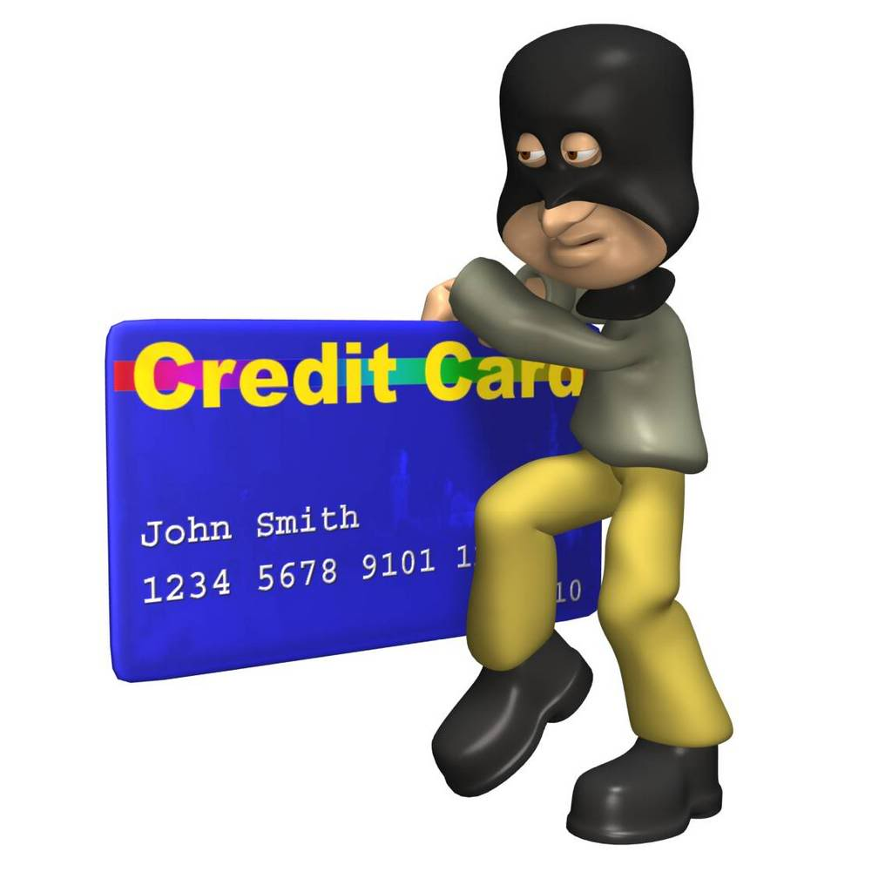
Notes:
Include somewhere, info on Special Access code you input letter with code b4 scan to bring up specific data (ex. P99135 =Passport)

Slide 2
Trumell Arnum
Grade 12
Age 17
Notes:
Done

Slide 3
Mission Statement
Opportunity
Identity theft incidences increased by 11% from 2008 to 2009.
TrustID eliminates the opportunity for someone to use your information as their own.
People often carry their credit/debit cards, social security card, drivers license etc. all at the same time.
Never before has there been a universal Identification product.
Mission Statement
TrustID will allow the world to advance in terms of technology and will allow all customers the comfort of knowing their personal information is protected.
Notes:
Done

Slide 4
Business Profile
TrustID is a retailing and manufacturing business.
Applies to everyone who carries around or has personal information.
A common trusted method used in storing personal information.
TrustID is a Limited Liability Corporation
The legal structure was selected to protect my personal assets in the event that my business is unsuccessful.
Notes:
Done

Slide 5
Qualifications
Internship at CIGNA
A well educated student
Honest, Trustworthy, Hardworking, Friendly, and Determined
I have taken Small Business management class
Notes:
Done

Slide 6
Market Analysis
Industry Name | Professional Technical Services
Industry Size | $82,846,113,000
Total Population | The United States of America
Target Market | Legal citizens in the United States of America Who have personal information cards (credit/debit cards, social security card, drivers license, Passport etc.)
Potential Market | Survey Data taken: More than 50% of target market showed interest in my product.
Total Population
312,774,325
Target Market
226,448,611
Potential Market
6,538,131
Notes:
Average passport purchases per year (14,060,496)
93% of Pass Port population own both PP and DL (13,076,261)

Slide 7
Target Market
By Location
The United States of America
By Population
Male and female Americans between the ages of 20-85+ with any level of formal education.
By Personality
College students and typical American adults with part time or full time jobs.
By Income
Lower, Middle, and upper class households.

Slide 8
Competitive Advantage
Drivers
license
Passport
Card
& Book
Factors
Price
$72 or $82New
$30.00 Renewal
$165.00 New
$140.00 Renewal
$165.00New
$125.00 Renewal
Quality of
Product/Service
Great
Great
Great
Location
Nationwide
Nationwide
Hartford HQ
Reputation/Brands
Great
Great
Good
Unique Factors/
Knowledge
Experience
Experience
Information Protection

Slide 9
Marketing Mix
People
Product
Place
Price
Promotion
TrustID will be promoted through word of mouth with the addition of an online website.
TrustID targets lower, middle and upper-class Americans between the ages of 20-85
TrustID is a national business who provides for all interested individuals in the U.S.
A universal identification method designed to prevent identity theft.
Lower than buying a drivers license and passport individually with more information stored.

Slide 10
Promotional Mix
Promotional Expense
Monthly
Amount
Advertising
$40.00
Word of Mouth, Business Cards, Website
Publicity
FaceBook, MySpace, Twitter, other Social Networks, Identity theft Website Hosting.
$8.00
Sales Promotion
Discounted renewal fees for previous TrustID customers
$0.00
Total Monthly Promotional Expense
$48.00

Slide 11
Cost of Material
Materials
Material Description | Total Quantity per Card | Cost per Unit
Postage | 1 | $0.61
Activation Sticker | 1 | $0.03
Processing | 1 | $0.27
Plastic/Ink | 1 | $0.17
Premium Memory Chip | 1 | $3.00
Shipping to Processor | 1 | $0.03
Total Material Cost per Unit |  | $4.11
Labor
Labor Cost per Hour | Time (in hours) to Make One Unit | Labor Cost per Unit
$0 | 0 | $0
Total Labor Cost per Unit |  | $0
COGS (per Unit) | $4.11
Notes:
Dynamic Card Solutions, a company based in Englewood, Colo. (Company that makes cards)

Slide 12
Economics of One Unit
Selling Price (per Unit) | $165.00
COGS (per Unit) | $10.11
Other Variable Expenses (per Unit) | $10.00
Total Variable Expenses (per Unit) | $20.11
Contribution Margin (per Unit) | $144.89
Notes:
$4.11 to make a card with a premium memory chip
Datacard RP90 Plus E Color Dye sublimation printer - 300 cards
$4,251/10 online

Slide 13
Monthly Fixed Cost
Fixed Expense | Average Monthly Expense
Insurance | $100.00
Salaries of Employees | $0.00
Advertising | $40.00
Interest | $0.00
Depreciation | $23.42
Utilities (Gas, Electric, Telephone) | $20.00
Rent | $50.00
Other Fixed Expenses | $0.00
Total Average Monthly Fixed Expenses | $243.42
Notes:
Salary Average $10 per hr. standard 9-5

Slide 14
Time Management
Total Hours in a Week = 168

Slide 15
Monthly Sales Predictions First Year
Total Units Sold
6,500,000

Slide 16
Projected Yearly Income Statement
Selling Price per Unit | $165.00
Number of Units Sold | 6,500,000
Total Sales | $1,072,500,000
Variable Expenses | $130,715,000
Contribution Margin | $941,785,000
Fixed Operating Expenses | $2921.04
Pre-Tax Profit | $941,782,078.96
Taxes @ 15% | $141,267,311.70
Net Profit | $800,514,767.26

Slide 17
Start-up Investment
Start-Up Expenditures
Item | Where Will I Buy This? | Cost
Data Card RP90 Plus E Color Dye sublimation printer | www.Datacard.com | $4251.00
Visitor Pointe Software | www.Datacard.com | $500.00
Software Development |  | $1,000,000.00
Total Start-Up Expenditures |  | $1,004,751.00
Cash Reserves
Emergency Fund | $ 500.00
Reserve for Fixed Expenses | $ 600.00
Total Start-Up Investment
$1,005,851.00
Notes:
Datacard RP90 Plus E Color Dye sublimation printer

Slide 18
Return
ROS: Return on Sales
For My Business: | Dollar Equivalent =
Annual Net Profit
Annual Sales
X 100= 75%
$0.75
ROI: Return on Investment
For My Business: | Dollar Equivalent =
Annual Net Profit
Start-Up Investment
X 100= 79585.82%
$795.86

Slide 19
Financing
Total Start-Up Investment
$
Source | Amount | Debt | Equity | Gift
Personal Savings | $3,500.00
Relatives/Friends | $2,500.00 | $2,500.00
Angel Investor/Venture Capitalists | $1,000,000 | 49% Ownership
Partner(s)
Totals | $6,000.00 | $2,500.00

Slide 20
Philanthropy
1,000,000 Annual Donation to Children Research

Slide 21
Business & Personal Goals
Business
Personal
Get equipment
Find liable sponsor
Finish high school, and obtain a college degree
Attract employees
Short-Term
More information on programming
Cigna officials for tips on managing personal info
I plan to run my business until death.
This business can be my career.
Long-Term

Slide 22
Thank you for your consideration.

