Slide 1
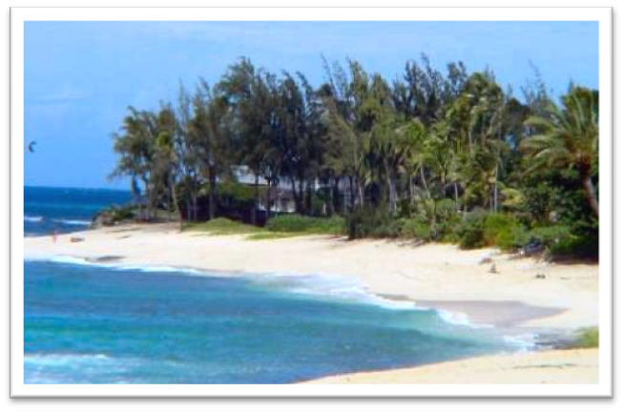
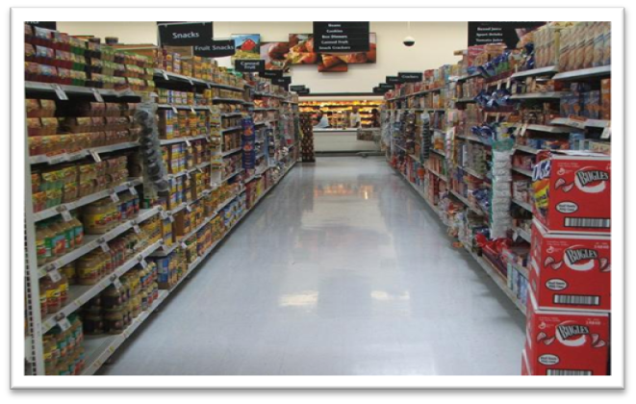
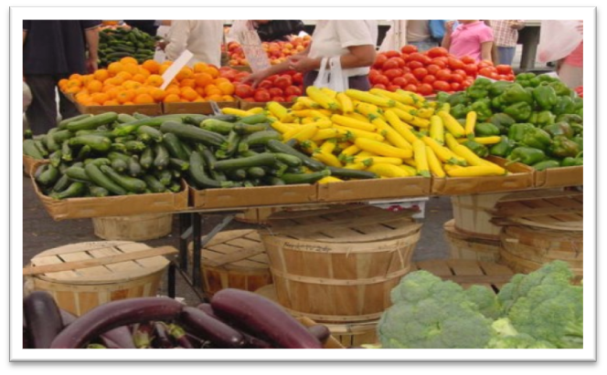
Notes:
Student Notes:
Assessments
To evaluate your potential as an entrepreneur, you can complete any or all of the following self assessments (either in BizTech or the Business Plan Project in your Student Activity Workbook).
Section 1.1: “What Is Entrepreneurship?” In BizTech or pgs. 223-225 in the Business Plan Project.
Section 1.2: “Characteristics of an Entrepreneur.” In BizTech or pgs. 226-229 in the Business Plan Project .
Section 2.1: “Importance of Entrepreneurship in the Economy.” In BizTech or pgs. 233-235 in the Business Plan Project.
Section 2.2: “Thinking Globally, Acting Locally.” In BizTech or pgs. 237-239 in the Business Plan Project.
Business Plan Exercises
This slide relates to the following business plan exercises:
Section 1.2: “Entrepreneurship Characteristics & Skills.” In BizTech or pgs. 230-232 in the Business Plan Project (Student Activity Workbook). Focuses on the business idea, business name, academic and work qualifications, personal characteristics and skills, and entrepreneurial characteristics).
Section 2.1: “Factors that Influence Demand.” In BizTech or pg. 236 in the Business Plan Project (Student Activity Workbook). Focuses on understanding supply and demand for your product or service.

Slide 2
Matthew Butler
Grade 11
Pathways to Technology

Slide 3
Mission Statement
Mission Statement
Help people use recycled materials and help give back to children without education.
Opportunity
My product is a woven plastic basket made of recycled materials.

Slide 4
A Good Cause
It only costs $30 to
educate a
child in a third world
Country like Viet Nam
5% of my profits will go to help these children.

Slide 5
Business Profile
Type of Business
Retail
Buying whole sale from Viet Nam
Legal Structure
Limited Liability Corporation

Slide 6
Qualifications
I’m qualified to run this business because:
❶
❷
❸
Entrepreneur and Small Business Class at Pathways
Efficient Worker
Experienced Seller

Slide 7
Market Analysis
Industry Name | Clothing Accessory Retail
Industry Size | $7,000,000,000
Total Population | Hartford County, CT
Target Market | People 16 and older.
Potential Market Size | 66% of those surveyed stated that they liked the basket and felt reasonably priced.
Total Population
877,000
Target Market
645,000
Potential Market Size
425,000

Slide 8
Target Market Segment
Demographics
People 16 and older.
Geographics
Greater Hartford area
Psychographics
At least 60% of people in Hartford County enjoy going to the beach, and other places like markets and farms.
Buying Patterns
People who:
Use their own grocery bags
Frequent farmer’s markets
Beach goers
BJ’s Members

Slide 9
Competitive Advantage
Factors
Butler’s
Baskets
Walmart
Storable.com
Price
$20.00
$49.00-99.99
$13.99
Quality of
Product/Service
Tightly Woven
Variable
Good Washable
Location
Hartford County
Across America
Online
Reputation/Brands
Helps Children
Cheap, Breakable
Good
Unique Factors
Knowledge
Seen Production
Retail SuperStore since 1962
Customer and Business Experience

Slide 10
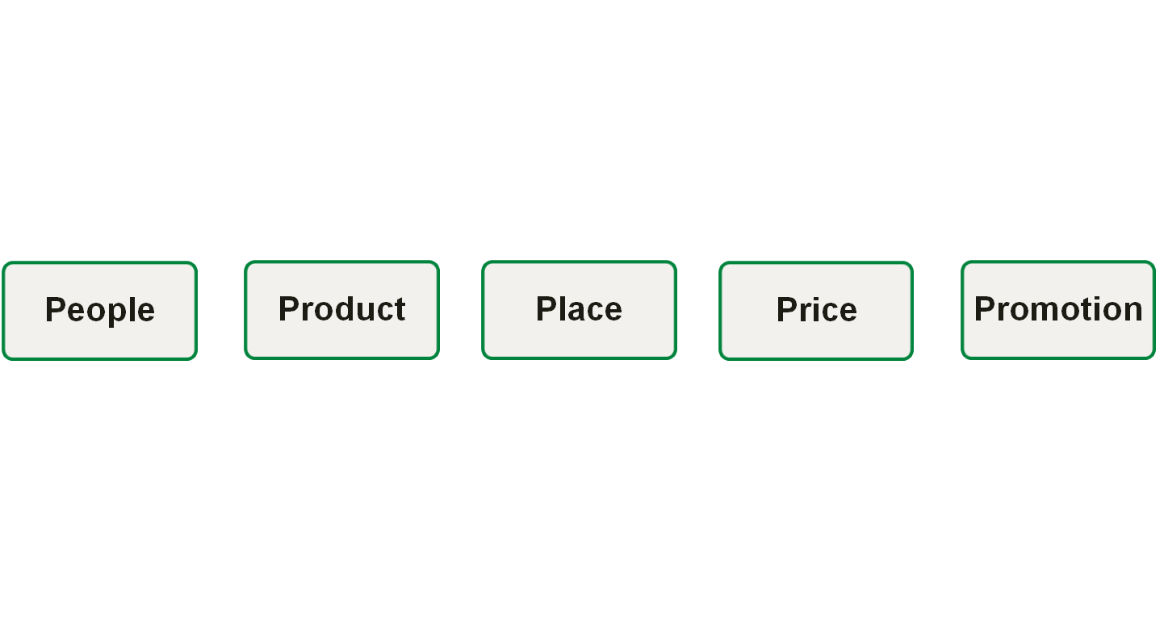
Marketing Mix
People with different needs and want a universal basket
Where ever they may be needed, sold at beach, supermarkets or farms.
I will promote my business with Craigslist, other free ad sites, and facebook.
My product is a hand woven plastic baskets made with recycled plastic.
The price is an affordable $20.

Slide 11
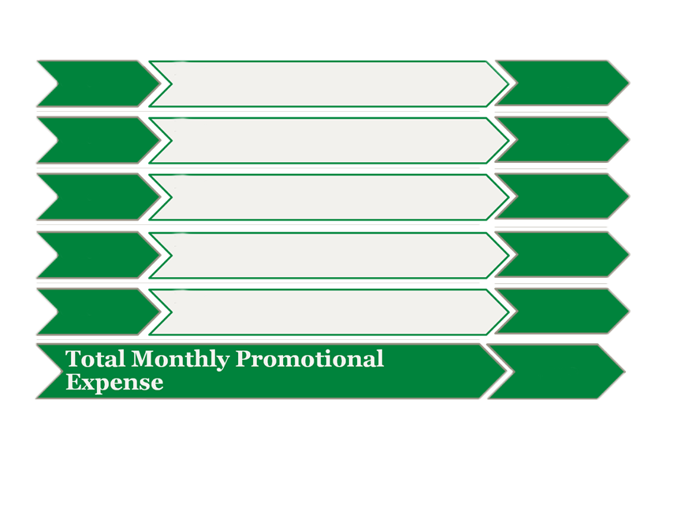
Promotional Mix
Promotional Expense
Monthly
Amount
Advertising
Craigslist postings in Hartford Area and free listings in local news papers
$0
Publicity
Flyer attached to or inside basket
$10
Personal
Selling
Selling locations around Hartford County
$200
Sales
Promotion
For the first two weeks you get 15% off when you refer a friend
$20
Other
None
$0
$270

Slide 12
Cost of Materials/Labor
Materials
Material Description | Cost/Total Quantity | Cost per Item
Basket | $2/1 | $2
Total Material Cost per Unit |  | $2.00
Shipping
Shipping Cost per Basket | Time (in Days) to ship | Shipping Cost per Unit (10)
$5.00 | 6 | $50
Total Shipping Cost per Unit |  | $5.00
COGS (per Unit) | $7.00

Slide 13
Economics of One Item
Description of One Unit of Sale
One Plastic Woven Basket made from Recycled Materials
Selling Price (per Item) | $20.00
COGS (per Item) | $7.00
Other Variable Expenses (per Item) | $0.00
Total Variable Expenses (per Item) | $0.00
Contribution Margin (per Item) | $13.00

Slide 14
Average Monthly Fixed Expenses
Fixed Expense | Average Monthly Expense
Insurance | $50
Salaries of Employees | $0
Advertising | $50
Interest | $0
Depreciation | $0
Utilities (Gas, Electric, Telephone) | $260
Rent | $0
Other Fixed Expenses | $0
Total Average Monthly Fixed Expenses | $360

Slide 15
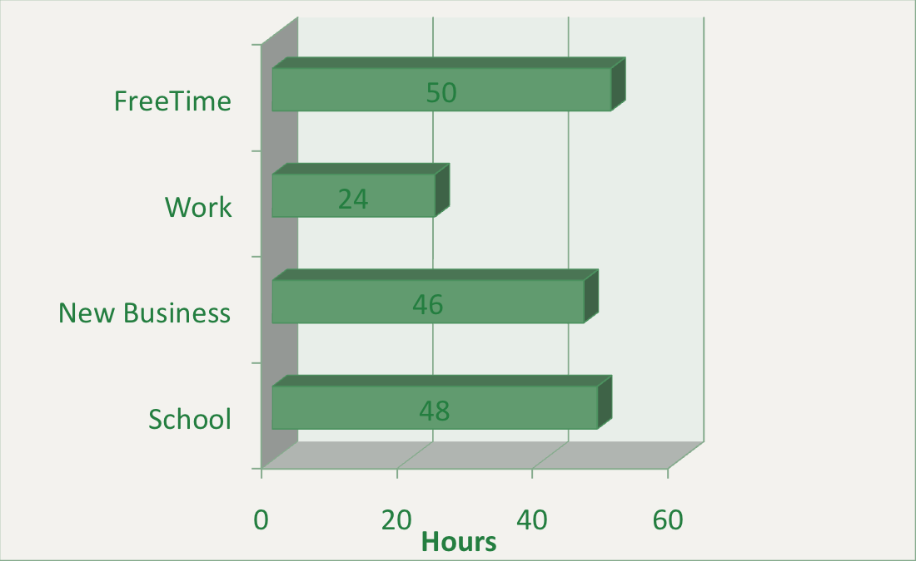
Time-Management Plan Schedule for a Typical Week
Total Hours in a Week = 168

Slide 16
Monthly Sales Projections First Year
Total Units Sold

Slide 17
Monthly Break-Even Units
Fixed Expenses Divided by Contribution Margin
$360.00/13.00=27.69
In an average month, the company will begin to make a profit after selling units.
27.69

Slide 18
Projected Yearly Income Statement First Year
A | Selling Price per Unit | $20.00
B | Number of Units Sold | 1725
C | Total Sales |  | $35,500.00
D | Variable Expenses | $3450.00
E | Contribution Margin |  | $31,050.00
F | Fixed Operating Expenses | $4,320.00
G | Pre-Tax Profit |  | $26,730.00
H | Taxes @ 15% | $4,009.50
I | Net Profit |  | $22,720.50

Slide 19
Start-Up Investment
Start-Up Expenditures
Item | Where Will I Buy This? | Cost
Set of 40 Baskets | Viet Nam | $280
Total Start-Up Expenditures |  | $280
Cash Reserves
Emergency Fund | $1,000.00
Reserve for Fixed Expenses | $500.00
Total Start-Up Investment
$1,780.00

Slide 20
ROS & ROI
ROS: Return on Sales
$25,559.50/$7,900.00*100=323% | Dollar Equivalent = $323.00
ROI: Return on Investment
$25,559.50/1600*100=1597% | Dollar Equivalent = $4081.85

Slide 21
Financing Strategy
Total Start-Up Investment
$1,780
Source | Amount | Debt | Equity | Gift
Personal Savings | $1,000 | $1,000
Relatives/Friends | $1,000 | $1,200
Totals | $2,000 | $2,200

Slide 22
Business Responsibility & Philanthropy
Business Responsibility
Each basket will have a small tag showing the picture of a student in Viet Nam who was helped by the purchase of a basket.
Philanthropy
5% of my funds are going back to Viet Nam to help educate students

Slide 23
Business & Personal Goals
Business
Personal
Keep business open in this economy.
Gain personal relationships with frequent customers.
Short-Term
Broaden location to increase profits.
Run business over next decade and then sell to larger corporation while keeping it’s same values.
Long-Term

Slide 24
Helping With Every Handle
Thank you for your consideration.
Butler’s Baskets

