Slide 1
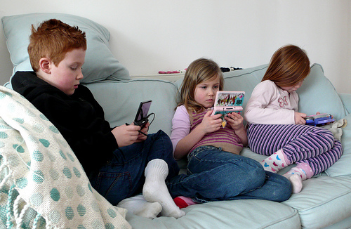
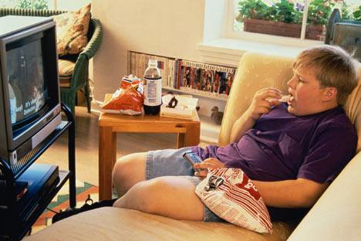
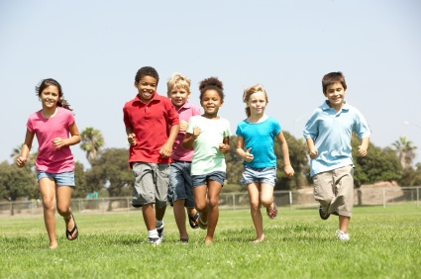
Kids today
What if ?

Slide 2
Fanbase 4 Kids
Lusus LLC
Eli Butters & Brandon Murillo
“The True Potential of the Youth.”

Slide 3
Problem Statement
Kids today lack fitness, and have become increasingly less involved in physical activity, resulting in a high rate of child obesity.
Professional sports teams have difficulty finding fans of a younger age, which they need in order to have a strong group of fans for the future.

Slide 4
Solution
Fanbase 4 Kids
Mobile application
Encourages physical activity through:
Photo/ Video submission contests
Achievements for getting exercise
Each app for a different professional sports team
Kids more involved as a fan

Slide 5
Mission and Social Impact
Mission:
At Lusus LLC, we aim to promote the widespread adoption of a healthier lifestyle through increased interest and participation in physical activity, including causal, recreational, and professional sports.
Social Impact:
Decrease in obesity rates, greater interest and participation in physical activity, healthier lifestyle

Slide 6
Features
Photo/ Video submissions + contests
Point System
Team Trivia Game – members, stats, schedule, scores, etc.
Team News Updates
More Features Integrated Over Time

Slide 7
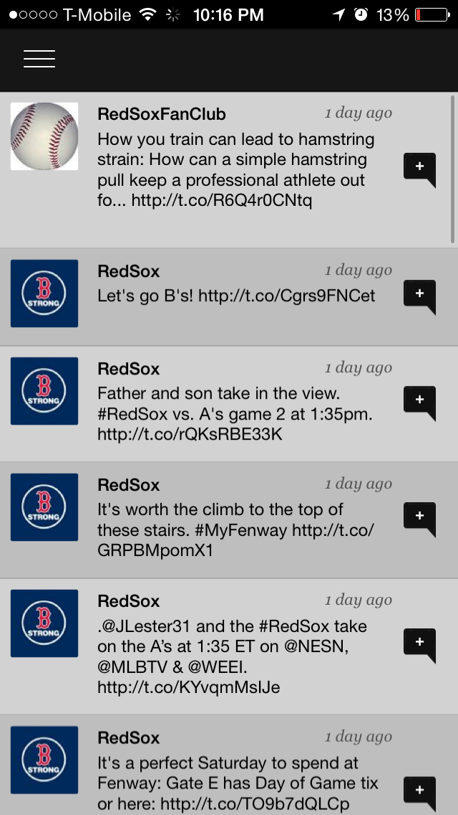
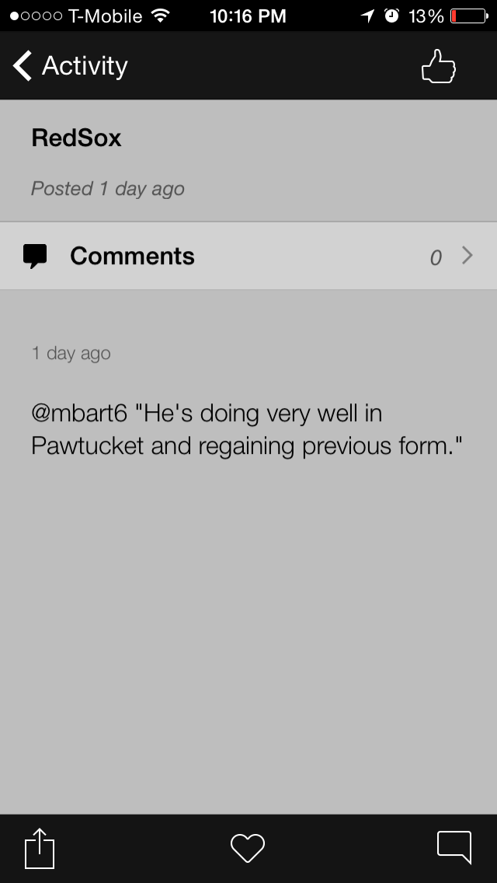
Screenshots

Slide 8
Business Model

Slide 9
Market Analysis

Slide 10
Marketing and Sales
Annual Purchase for Product Creation and Maintenance of $10,000.00 by Team
Team pays $.40 per DL
Downloadable for free off of the Apple App Store and Google Play
Working with Sports Teams
Promotion

Slide 11
Competition

Slide 12
Qualifications
4+ Years Programming Experience
4+ Years Web Design Experience
Mobile Application Development Course
Entrepreneurship Course
Lifetime involvement in sports
Connections (With professional teams and leagues)

Slide 13
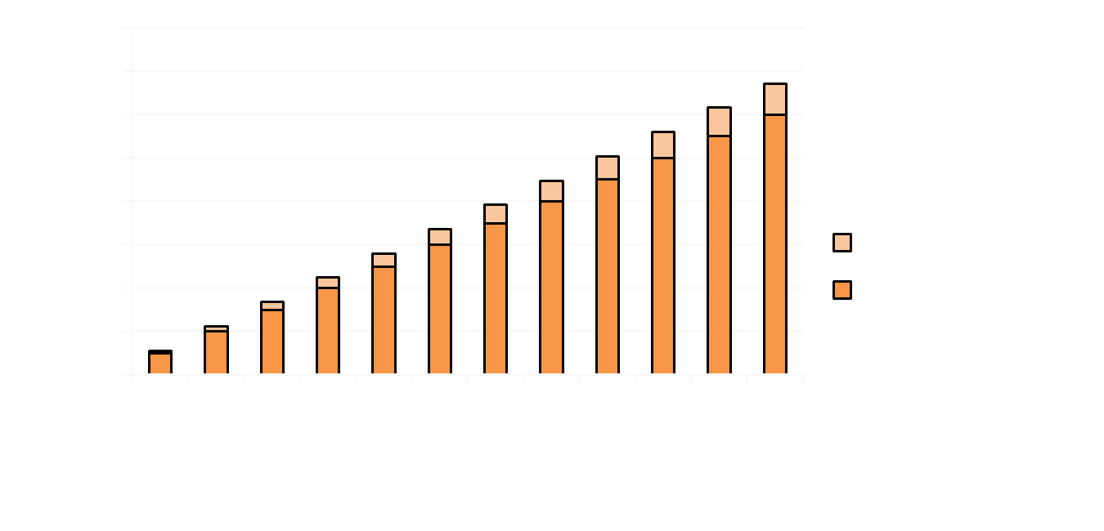
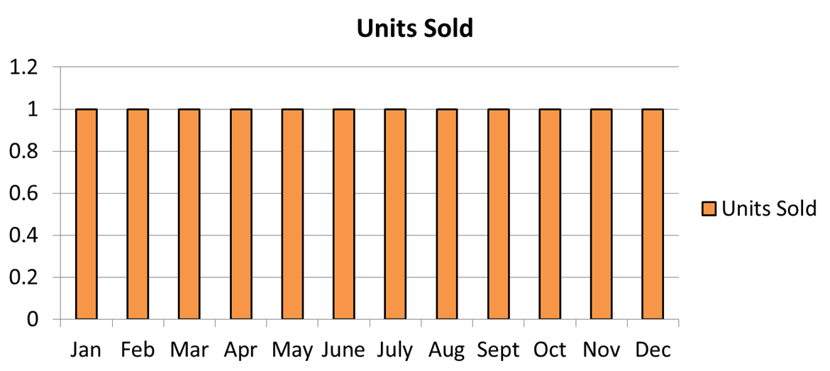
Sales Projections
Notes:
Estimated one Application Package sold per month
Basing Gross Revenue on $10,000 start-up fee and an estimated average 3000 downloads per app at $0.40 per app ($134,400)
Variable expenses ($18,000) = Gross Profit of $116,400
Fixed expenses ($8,415) = Pre-Tax profit $107,985
20% Tax ($21,597) = Net Profit $86,388

Slide 14
Start-Up Funds

Slide 15
Future Plans
Expansion
Updates:
Team Info
Games
Accelerometer
Attend College

Slide 16
Current Status
Website:
http://SportsBuildup.Weebly.com
Working Prototype

Slide 17
Fanbase 4 Kids
Lusus LLC
Eli Butters & Brandon Murillo
“The True Potential of the Youth.”

