Slide 2
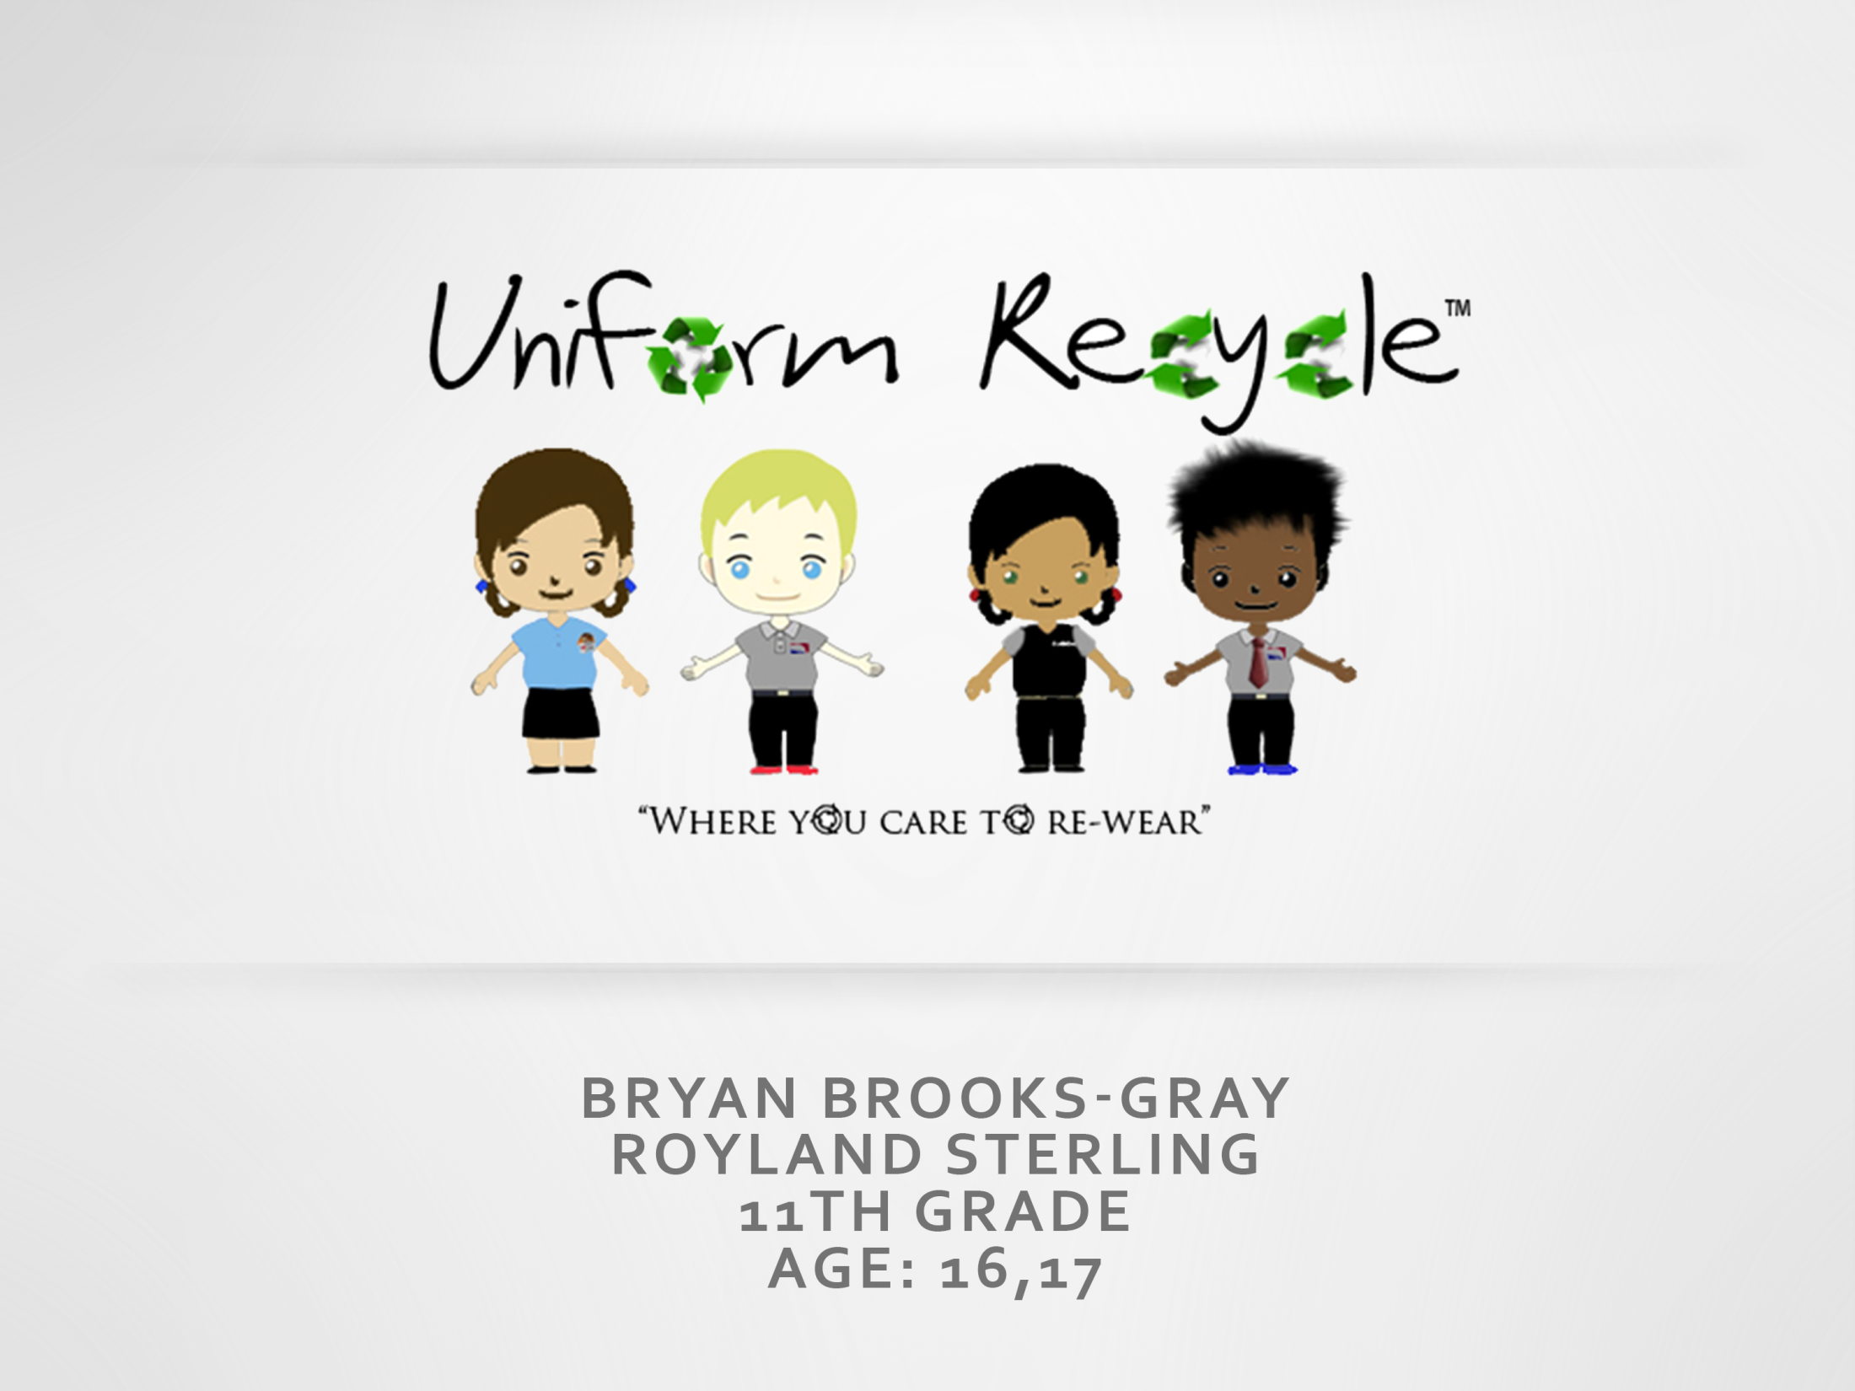

Slide 3
Mission Statement
Mission Statement
Our mission at Uniform Recycle is to provide parents a way to save money on school uniforms and for schools to produce additional funds, all while promoting sustainability. We are committed to reducing our consumption and waste, reusing what we have, and recycling everything we can. We believe that the earth is worth saving and therefore we offer ways to provide parents and schools with an easy convenient way to help our environment.
Opportunity
To provide environmentally friendly way to lessen the amount of clothing disposal in landfills
To provide additional money revenue for schools
To aid in the costs associated with the school uniforms clothing of young people in our community
To offer parents an alternative choice to expensive uniforms
To create partnership with established uniform companies
To live what we sell

Slide 4
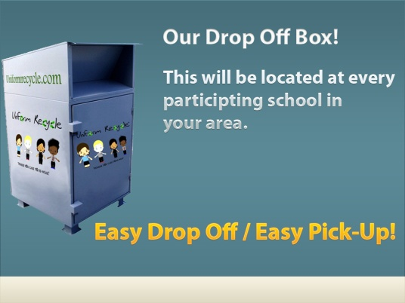
Business Profile
Type of Business
Uniform Recycle is service/retail business
Uniform Recycle takes and recycles uniforms from:
Children who have outgrown uniforms
Children who no longer have a need for uniforms
One of our goals of our business is to reduce the amount of clothing waste that people produce.
Legal Structure
Uniform Recycle is considered an entity and will be owned by its partnered members. Therefore we will be established as an LLC giving us the ability to combine the liability benefits of a corporation with tax benefits of a partnership.
We selected this legal structure because there are two of us with different skill sets and talents that we can bring to this business.

Slide 5
Qualifications
Completed NFTE entrepreneurial course
Experienced in retail sales
Trustworthy and reliable
First hand experience with waste generated with school uniform (We have worn uniforms for the past 5 years)

Slide 6
Market Analysis
Industry Name | Clothing Industry
Industry Size | $150 billion
Total Population
Total Population | Hartford
Target Market | Families of Hartford Public Schools, Private Schools, Vocational Schools and State Schools
Potential Market Size | Hartford Public Schools students and their families
124,062
Target Market
41,957
Potential Market Size
26,587
Notes:
Uniform Recycle will be a leader in the clothing recycle business sector. Our innovative solution to uniform costs will make the process of ordering and securing school uniforms effortless, all the while providing an unprecedented support system for our customers.

Slide 7
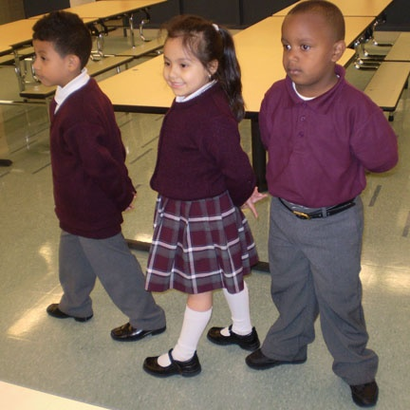
Target Market Segment
Demographics
Adults/male and female, 25+, with children K-12
Low and middle income families
Geographic's
Hartford County, especially the city of Hartford and the Hartford Public School System. (Will expand in future)
Buying Patterns
Consumers who repeatedly buy school uniforms for their children.
Consumers who like the convenience and ease of pick-up and drop-off delivery.
Cost conscious shoppers.
Income
Low and middle income families.

Slide 8
Competitive Advantage
Uniform Recycle
Shirt Man
Living Words
Imprints
Factors
Price
$12
$21
$20
Quality of
Product/Service
Good
Good
Good
Location
Hartford
Hartford
Hartford
Reputation/Brands
Developing
Good/Varies
Good/ Varies
Unique Factors/
Knowledge
Recycled uniforms / Credit to reduce costs further
Work with schools to distribute new uniforms
Does custom shirts/school uniforms
Notes:
Our search for competitors has yield little direct competition. With the increase the number of school requiring uniforms and the average cost per child per family being $300.00, a noticeable increase in the uniform/clothing industry has taken place. Main competitors include CT-Shirt Man and Living Word Imprints which are both involved in the uniform clothing sector but only supplying new clothing while Goodwill, Salvation Army, and Big Brothers Big Sisters have an impact in the used clothing arena but have very little concern about the used uniform sector leaving Uniform Recycle as the only used uniform supplier at this time… full market share. We save time… Providing easy convenient drop off and pick of the uniforms and support services that other companies don't. We save money… Uniform Recycle can cut the family contribution in half or more. We Save the environment… No driving... No gas... No CO2...No clothing waste…Recycle, Reuse, Re-wear

Slide 9
Marketing Mix
People
Product
Place
Price
Promotion
Adults male and female, 25+, with children K-12
Hartford :local area knowledge, familiar with schools, personal experience
Social Networking, Public TV, Flyers to schools,
Shining Star (Hartford Public Schools Internal Communications)
Gently used uniform shirts, pants, and accessories
$12 for a pant or shirt
$2-$8 for accessories

Slide 10
Promotional Mix
Promotional Expense
Monthly
Amount
Advertising
Door hangers, Flyers/school, Icontact.com, Bus wraps, Marketing packets
$80.00
Personal Selling
Distribute drop off boxes at school and to talk to kids about recycling their uniforms
$0.00
Sales Promotion
Other
Punch cards for repeat customers, Additional family discount, online coupons
The C.T. Shirt Man has asked if they could partner with us when our business is started
$0.00
Total Monthly Promotional Expense
$88.00
$8.00
FaceBook, MySpace, Word of mouth from school to school, Twitter, Social Networks, Green Website Hosting
Publicity
$0.00

Slide 11
Cost of Materials/Labor
Materials
Material Description | Cost/Total Quantity | Cost per Unit
Cash buy back | $2.00/Shirt or Pant | $2.00
Credit | $4.00/Shirt or Pant | $4.00
Donation | $0.00/ Shirt or Pant | $0.00
Clothing bag | $0.03 /bag | $0.03
Total Average Material Cost Per Unit $3.03
Labor Cost per Hour | Time (in Hours) to Make One Unit | Labor Cost per Unit
$8.00 | 1/60 hr per unit | $0.13
Total Labor Cost per Unit |  | $013
COGS (per Unit) | $3.16

Slide 12
Economics of One Unit
Description of One Unit of Sale:
One Shirt or One Pair of Pants
Selling Price (per Unit) | $12.00
COGS (per Unit) | $3.16
Other Variable Expenses (per Unit) (School Commission) | $1.00
Total Variable Expenses (per Unit) | $4.16
Contribution Margin (per Unit) | $7.84

Slide 13
Average Monthly Fixed Expenses
Fixed Expense | Average Monthly Expense
Insurance | $50.00
Car rental (parents) | $60.00
Salaries of Employees | $0.00
Advertising/Promotion | $88.00
Interest | $0.00
Depreciation | $0.00
Utilities (Gas, Electric, Telephone) | $60.00
Rent | $100.00
Other Fixed Expenses | $0.00
Total Average Monthly Fixed Expenses | $358 .00

Slide 14
Time-Management Plan
Total Hours in a Week = 168

Slide 15
Monthly Sales Projections
Total Units Sold
2,600
Notes:
We have conservatively estimated that we will reach a minimum of 10% of targeted population. These numbers represent that population. Notice that the winter months sales are lower…….these months we will concentrate mainly on getting new schools on board as well as getting brand recognition. We also will concentrate on uniform inventory during these months. The spring and summer months will be our high production season because this is the time that people will be looking for uniforms for their children.

Slide 16
Monthly Break-Even Unit
Monthly Fixed Expense
Monthly Contribution Margin
$358.00
$1,722.50
= 21 units
In an average month, the company will begin to make a profit after selling units.
21

Slide 17
Projected Yearly Income Statement
A | Selling Price per Unit | $12.00
B | Number of Units Sold | 2600
C | Total Sales | $31,200.00 | $12 X 2,600
D | Variable Expenses | $10,816.00 | $4.16 X 2,600
E | Contribution Margin | $20,384.00 | $31,200-10,816
F | Fixed Operating Expenses | $4,296.00 | $358 X 12
G | Pre-Tax Profit | $16,088.00 | $20,384 – 4,296.
H | Taxes @ 15% | $2,413.00 | $16,088 × 0.15
I | Net Profit | $13,675.00 | $16,088 – 2,413

Slide 18
Start-Up Investment
Description | Cost
Web Costs
Domain name , web hosting (first three months) | 46.00
Equipment
Computer, printer, software | 1,600.00
Drop –off Boxes ($80 per box… 10 boxes) | 800.00
Printing Costs
Business Cards, flyers, door hangers | 200.00
Promotional Signs (Car Magnet) | 150.00
Other
License and permits | 150.00
Attorney’s fee | 1,000.00
First Months Car Insurance and Rent | 210.00
Cash Reserve (3 months of fixed costs) | 1080.00
Emergency Fund | 100.00
TOTAL | $5,336.00

Slide 19
ROS & ROI
ROS:
Annual Net Profit / Total Sales * 100
$13,918 / $31,200 x 100 = 45%
Dollar equivalent $0.45
ROI:
Annual Net Profit / Start-Up Investment * 100
$13,918 / $6,000 x 100 = 231%
Dollar equivalent $2.31

Slide 20
Financing Strategy
Total Start-Up Investment
$6,000
Source | Amount | Debt | Equity | Gift
Personal Savings | $3000
Relatives/Friends | $3,000 | $3,000
Investor
Partner(s)
Totals | $6,000 | $3,000

Slide 21
Business Responsibility & Philanthropy
Business Responsibility
We will put Green Corps logo on our business card to show our support for the environment with the hope that other people with the same vision will support us.
Philanthropy
Uniform Recycle will sponsor three student uniforms at each school for students that the school deems "needy."
We will also donate a percentage of our yearly net profit to GREEN CORPS

Slide 22
Business & Personal Goals
 | Business | Personal
Short-Term | Build partnerships with more schools Register our business | Graduate from high school with honors Attend college/university
Long-Term | Obtain a company vehicle Partner with established uniform businesses Expand business to other cities Think about franchising business | Earn a business degree Create a set of new business skills that will be used to enhance our lives and earning potential

Slide 23
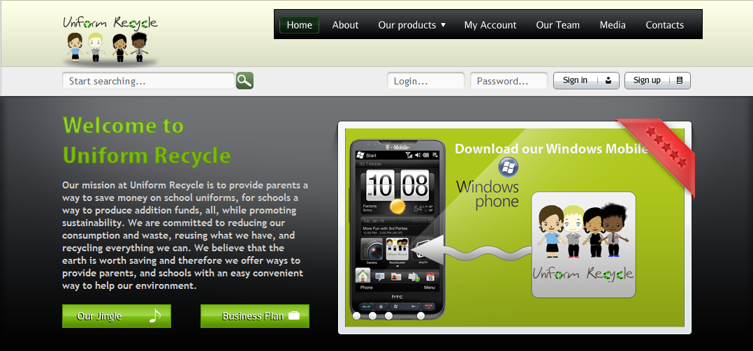
Where You Care to Re-Wear
Thank you for your consideration
Uniformrecycle.com

